Slide 1
Automated Quantification of Cellular Apoptosis and DNA Damage
Ross Jones – Singh Lab
2014 Capstone Proposal
Department of Bioengineering
University of Washington

Slide 2
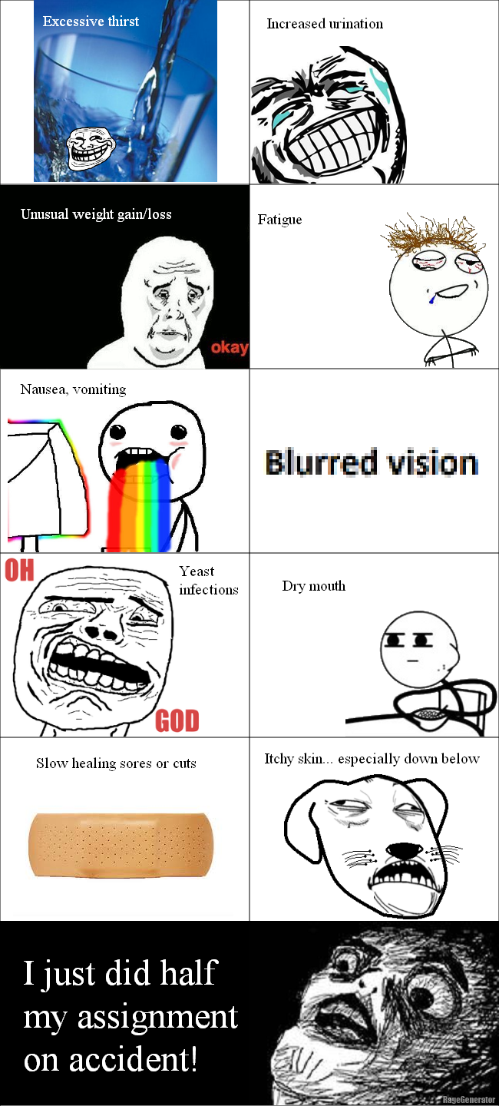
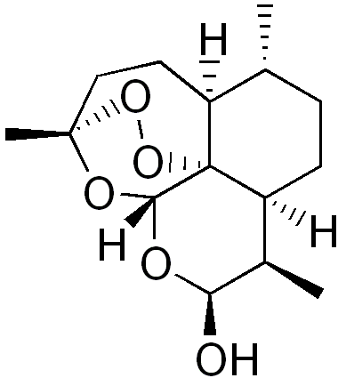
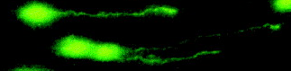
Ross Jones
Singh Lab
DNA damage / repair
Aging and cancer
Artemisinin for cancer therapy
DNA single molecule imaging
Singh NP et al. Mutation Research (1999)
Wikimedia Commons

Slide 3
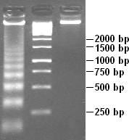
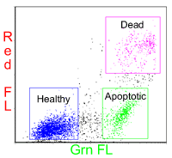
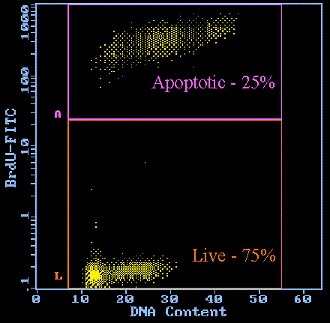
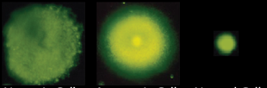
Background
Current problems in apoptosis evaluation techniques:
Poor sensitivity
Need large number of cells
Artifacts / false positives
Cell type detection issues
Relatively expensive procedures
Single cell methods: DNA diffusion and fast halo assays
Cannot assess adherent cells
Labor intensive analysis
Wikimedia Commons
Phoenix Flow Systems
Department of Carcinogenesis, The University of Texas M.D. Anderson Cancer Center, Smithville, Texas
Singh NP, Exp. Cell Res. (2000)

Slide 4
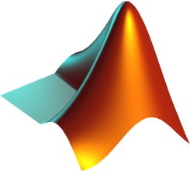


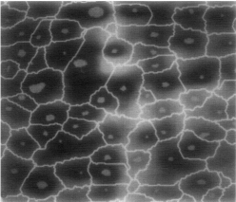
Direction
Research
Detachment Protocol
Assay comparisons
Design
Automatic image algorithms
Controlling program
Program GUI
Meyer F, Beucher S, J. of Vis. Comm. and Im. Rep. (1990)

